Slide 1
Rural Community Development Engagement, Co-Production, Collaboration and Economics Presenters: Michelle Murray, Dr. Barry Bruce and Julie McKercher

Slide 2
October 2015
Undertook a point in time assessment of the organizational situation in the community;
We let community down; it was "easier not to work there"
United Way Ottawa
So much potential for wraparound services: shifting sands – changing provincial landscapes, existing inventory of strengths and assets
Amalgamation "Hangover", service reductions, cynicism

Slide 3
Preconditions for change
The perfect storm ... or a great opportunity
The "plan" to engage
"With," not for
Collaboration with community and partners
"Preconditions" for transformational change:
Leveraging of key relationships
Results exceeded expectations

Slide 4
Community Feedback Cycle
Planning for engagement; whole system approach
Multiple channels of feedback to ensure diversity of voice
Results: Task force of champions
Straw dog; Implementation, feedback loop, stakeholders
Partnerships and Bricks and Mortar
More than just paying "lip service" - we start "walking the talk“
Priorities and the response have evolved beyond the deliverables
Co-production of services

Slide 5
Co-Production
The term co-production comes from economics
“Emphasises the importance of the collaboration between service providers and users….It is also known as co-creating services, whereby service recipients are involved in different stages of the process, including planning, design, delivery and audit of a public service”
(Boyle, Clarke and Burns 2006a; Needham and Carr, 2009).

Slide 6
Unexpected outcomes of consultation
Leveraged opportunities, including:
Federal funding to reduce rural Isolation for seniors "Reducing Rural Isolation"
The "Men's Ministry"; Rural funding & LHIN Health Equity research
Partnership with WCFHT to develop a de-facto health centre with a focus on SDOH

Slide 7
Potential Synergies : (FHT/CP & CSS) Family Health Team/Community Paramedic/CSS
Intentional focus on DOH AND primary care
Mental Health focus
Health promotion and prevention at the population and community level
“Customization” of person-centred care

Slide 8
Test Case: Embedded Community Paramedics (w/ Family Health Team)
Post / community engagement:
Collective next steps & the economics of SDOH
Experience and potential in providing physical care and emotional support

Slide 9
FHT “Embedded” Community paramedic
What is it?
Paramedic part of PCP “circle of care”, confidentiality, record sharing, face to face meetings;
…Providing
Eyes and ears in the home
Medication administration
Care coordination based on perceived needs
Care coordination based on patient goals

Slide 10
System Issues Antidotes
Organizational silos
Traditional medical
models
Fatigue, complacency, overly focussed
Resource silos
Largely undetermined
economics of DOH
Health Links philosophy
Medical models which include home services for complex and homebound patients
Change management
Pipelines to connect and redirect system “spender” resources to “system savers”
Use the economics we have, encourage more collaboration and collective impact
Notes:
Health Links philosophy
Traditional medical models Medical models which include home services for complex and homebound patients
Fatigue, complacency, overly focussed Change management
Resource silos Pipelines to connect and redirect system “spender” resources to “system savers”
Largely undetermined economics of DOH Use the economics we have, encourage more

Slide 11
Economics of SDOH
There are potential health care cost savings through a focus on the DOH
The size of expenditures
The collective impact in / of “moving the needle” …even a little

Slide 12
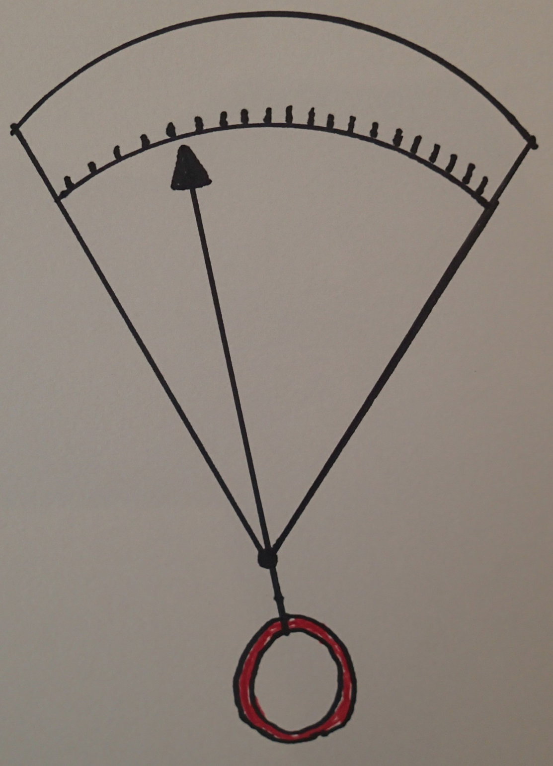
Moving the Health Care
Economic Needle for
West
Carleton
(…about 25,000 people)
Hospitals
Drugs
$150 Million
Primary Care
Public Health
Community and Social Supports
Notes:
The overall annual cost of health care for 25 thousand people is about $150 million. Each small gradation is about $7.5 million. In Ontario , the cost of drugs is about 16 %, and hospitals, about 33 % of the total, and together, about 50 % of the total. Primary Care, the Community and Social supports sector, and Public Health, have great leverage potentially – they can actuate the needle, which only has to move one gradation to save about $7.5 million.

Slide 13
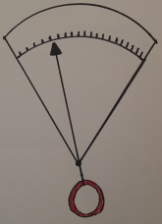
Primary
Care
Community and
Social Care
Hospital Care
What Sector Swings
The Needle?
Notes:
The Community and Social Care leverage the cost needle for primary care and hospital care. Primary care can also greatly influence hospital costs, and with even more effect when enabled by the ComSoc sector

Slide 14
Hospital admissions: HOSPITAL ADMISSIONS BEFORE AND AFTER CP DATE OF FIRST VISIT- VISITS PER QUARTER

Slide 15
Funding Implications: AGAINST AN ANNUAL COST OF $150,000 PER PARAMEDIC PILOT
The WCFHT saved ~ $1,500
The Ottawa Paramedic Service ~ $5,000
The Hospital System ~ $450,000
Internal funding not available through Primary Care or Ottawa Paramedic Service
Savings justify funding at the LHIN/MOHLTC level

Slide 16
The cost of inaction on the SDoH
“the most poor are twice as likely to suffer chronic illness and will die on average three years earlier than the most affluent…..”
…Research, centred on the social determinants of health, culminated in the World Health Organisation making a series of recommendations in it’s 2008 Closing the Gap Within a Generation report
CHA-NATSEM Second Report on Health Inequalities Catholic Health Australia 2012

Slide 17
Translation applied to the Canadian population….. annual gains (hospitals and drugs)
# fewer admitted to hospital 94 thousand
$ saved vis hospital admission reduction $3.6 Billion
# fewer Rx written 8.3 million
$ saved via fewer scripts $290 million
”These remarkable economic gains are only part of the equation. The real opportunity for action on social determinants is the improvements that can be made to people’s health and well-being.”

Slide 18
Collectively turning our focus on isolation as a key determinant of health

Slide 19
Important Research:
“Loneliness and Social Isolation as Risk Factors for Mortality: A Meta-Analytic Review” Julianne Holt-Lunstad1
(Brigham Young University - 2015)
Studies that provided quantitative data on mortality as affected by loneliness, social isolation, or living alone……. weighted average effect sizes were as follows: social isolation… loneliness…… and living alone
leading to an average of 29%, 26%, and 32% increased likelihood of mortality, respectively…… Results remain consistent across gender, length of follow-up, and world region
Isolation… risk for mortality is comparable with well-established risk factors for mortality

Slide 20
Smoking?
“Smoking imposes a huge economic burden on society— currently up to 15% of total healthcare costs in developed countries”
Translation to Canada - Total Healthcare costs in Canada were about $219 billion in 2015 – 15% of that would be about $31.5 billion annually
Economics of smoking cessation Steve Parrott – 20014 BMJ

Slide 21
Food insecurity & annual health care costs
“Total health care costs …”
When costs of prescription drugs covered by the Ontario Drug Benefit Program were included, the adjusted annual costs were 23% higher in households with marginal food insecurity (95% CI 16%-31%), 49% higher in those with moderate food insecurity (95% CI 41%-57%) and 121% higher in those with severe food insecurity (95% CI 107%-136%).”
CMAJ. 2015 Oct 6;187(14)

Slide 22
What’s the point? And, why focus on Isolation next?
If loneliness, social isolation and food insecurity are anywhere close to being as risky as cigarette smoking…
Healthcare cost implications are in the billions of dollars annually!
…and let’s not discount the importance of a degraded quality of life

Slide 23
Questions for you?
1) How successful will proposals be if there is no economic upside?
2) How might we make the business case for community based programs which are focused on the amelioration of DOH?

Slide 24
THE END

