Slide 1
Celebrating 30 years of the Ottawa Charter: Present Role of civil society in health promotion 6the Global Forum – PEI Declaration
Health Promotion Ontario Conference
Ottawa, Canada
Dr Mihály Kökény, PhD.
Former Minister for Health, Hungary
Senior Fellow, The Graduate Institute of International and Development Studies,
Geneva, Switzerland
mihaly.kokeny88@gmail.com
18-19 October 2016
Notes:
I try to introduce the state-of-play in HP in the light of the Curitiba Statement on Health Promotion and Equity (adopted by the 22nd Congress oh IUHPE), the recently held 6the Global Forum on Health Promotion held in in PEI - organized by the Alliance for HP and the draft documents of the WHO’s 9th Global Conference of HP .

Slide 2
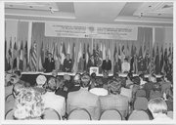
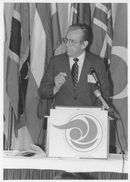
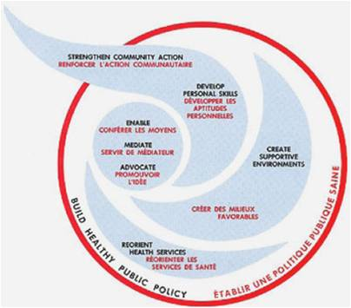
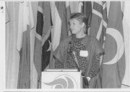
Looking back: The Ottawa Charter for Health Promotion

Slide 3
The term of health promotion
Health promotion has been defined by the World Health Organization’ s Bangkok Charter (2005) as "the process of enabling people to increase control over their health and its determinants, and thereby improve their health”.
The primary means of health promotion occur through developing healthy public policy that addresses the prerequisites of health such as income, housing, food security, employment, and quality working conditions.
There is a tendency among public health officials and governments—and this is especially the case in liberal nations—to reduce health promotion to health education and social marketing focused on changing behavioural risk factors.

Slide 4
The world has changed since Ottawa
Politics and economy: instead of 2 super-powers there is a multipolar arrangement (China, USA, Japan, EU and more on rise)
Digital revolution : internet, mobile phones, Facebook, Twitter, etc.
Urbanization (more than half of the world population lives in cities, increasingly in slums)
Progress in medicine: invasive cardiology, genetic engineering, robotic assisted surgery, new imaging technologies, personalized chemotherapy – life expectancy at birth increased by 7 years, with huge inequalities
Ageing: people over 60 have doubled
Global warming – more disaster due to extreme weather

Slide 5
Health promotion: where are we now?
Principles, action strategies of the Ottawa Charter still hold – it seems necessary to link them to the 21st century determinants of health: unsustainable consumption patterns, increased flow of people, accelerated pace of life
Challenges went global: urbanization, climate change, etc. - requiring global responses
More focus on health inequities (since the SDH report of WHO)
Health became political: the determinants of health – social, economic and environmental challenges and demographic changes affecting both people’s health and health systems presuppose political decisions
The bottom-up approach has been somewhat lost except the worldwide network of Healthy Cities and some countries (e.g. Thailand, Africa)

Slide 6
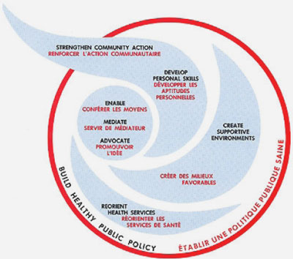
Role of civil society in health promotion: The basics
Health promotion works through concrete and effective community action in setting priorities, making decisions, planning strategies and implementing them to achieve better health. At the heart of this process is the empowerment of communities - their ownership and control of their own endeavors and destinies.
Community development draws on existing human and material resources in the community to enhance self-help and social support, and to develop flexible systems for strengthening public participation in and direction of health matters. This requires full and continuous access to information, learning opportunities for health, as well as funding support.
The Ottawa Charter for Health Promotion

Slide 7
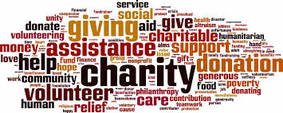
NGO definition
A legally created organization that operates independently from government
Private organizations that pursue activities to relieve suffering, promote the interest of the poor, protect the environment, provide basic social services or undertake community development (World Bank)
Social benefit organizations
Civil society organizations
Notes:
It includes foundations of the business sector.

Slide 8
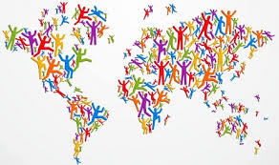
What NGOs can do in promoting health?
Provide timely, credible information
Reach populations difficult for government agencies to reach
Encourage people to prepare and practice healthy habits
Provide encouragement in ways that are appropriate and meaningful for the community
Serve as a safety net by providing services that might be disrupted (during the crisis in Greece)
Provide emotional support and comfort

Slide 9
WHO reform: Framework of Engagement with Non-State Actors
It took 6 years of contentious policy debates to come up with the first UN Framework managing Non-State Actors (2016)
FENSA contains rules for registration, criteria of cooperation, secondments from CSOs
Concerns remained over the undue influence of the private sector through their support to CSOs
Large philanthropic donors such as the Bill and Melinda Gates Foundation could make WHO dependent on their strategies (assessed contributions from Member States provide less than a quarter of WHO’s income – no pledge to increase)
Still unanswered: how and in which feasible formats CSOs could participate in shaping global health decisions (including in WHO)?
Notes:
Diverging views have emerged on how the voice of non-state stakeholders would be better heard and taken into account. How will WHO foster and enhance democratic inclusiveness in a global health organization in times when it has to demonstrate more efficiency and outcome orientation? Also, the 193 WHO Member States are keen to preserve their exclusive rights to make decisions within this inter-governmental UN organization – and they should. But ways must be found to fulfill the constitutional coordinating role of WHO, so that other global health actors can participate in initiating and shaping decisions.

Slide 10
Curitiba Statement on Health Promotion and Equity
Democracy and human rights are essential conditions for the promotion of health and equity.
Austerity causes inequity. The right to health should not be treated as a commodity.
Health promotion is influenced directly and indirectly from politics and ideologies. Demonstrate better and more transparent use of politics and power.
The local level exerts great transformative potential.
Health promoters must work to assure ownership and agency with the people they work with.
The world calls for new processes to effective social participation and inclusion.
Notes:
Clear and concise document.

Slide 11
PEI Health Promotion Declaration – October 2016 Charlottetown Call for Action: Health Promotion for Sustainable Development (1)
The Ottawa Charter continues to provide a solid foundation we can build upon.
The achievement of the SDGs is dependent on CSOs and the central role they play within health promotion.
Governments exercise political will at all levels, acknowledge the contributions of civil society and work with them to create health across all sectors.
Civil Society organizations work together through strengthening their networking, advocacy, communication and evidence creation efforts in order to keep HP on the agenda.
WHO and governments create enabling environments for intersectoral collaboration and working in partnership with Civil Society organizations.

Slide 12
PEI Health Promotion Declaration – October 2016 Charlottetown Call for Action: Health Promotion for Sustainable Development (2)
A Global Treaty on Health be developed by UN member states in the context of Global Governance for Health and recognize the roles of CSOs to contribute to it.
WHO focus attention and resources to make sure that HP strategies are more widely known and applied, and health promotion strategies are built into WHO work; from planning, to resource allocation, to training of health professionals globally, so that these skills are available at both local and national levels in all countries.
WHO and national governments invest in research about the effectiveness of implementing multi-level, multi-action, and civil society-engaging health promotion strategies towards advancing the SDGs.

Slide 13
Towards a framework convention on global health Lawrence O Gostin , Eric A Friedman , Kent Buse , Attiya Waris, Moses Mulumba, Mayowa Joe, Lola Dare, Ames Dhai & Devi Sridhar
The sustainable development agenda, however, cannot achieve global health with justice without robust global governance. We urge adoption of a legally binding global health treaty – a framework convention on global health grounded in the right to health.
A framework convention would establish a health financing framework with clear obligations, and would create an accountability regime with robust standards, monitoring and enforcement. It would advance health justice through engaging marginalized and underserved populations in making and evaluating policies and through comprehensive strategies and targeted interventions designed to overcome the barriers that prevent these populations from enjoying the conditions required for good health. Governments would be held to high standards of good governance, namely inclusive participation, transparency, honesty, accountability and stewardship. The framework convention would empower people to claim their right to health.
A framework convention would help elevate health and place it closer to the centre of the goals and activities of other international legal regimes, including through the establishment of a multisectoral consortium led by WHO.
Bulletin of the World Health Organization 2013;91:790-793.
Notes:
Creating a global health treaty: it is possible through hard work. FCTC is a good example.

Slide 14
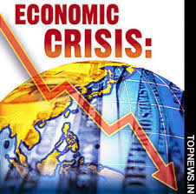
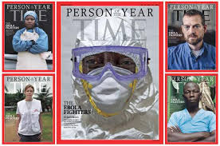
9th Global Conference on Health Promotion (1) Shanghai, 21-24 November 2016 Highlights by Draft Declaration
Health promotion compellingly contributes to the Sustainable Development Agenda by:
addressing the interdependence between sustainable health and well-being and the health of the planet;
empowering people to increase control over their health and ensuring inclusiveness and voice;
reducing health inequities caused by the unequal distribution of funds, power and resources;
acting on the cross-cutting political, economic, social, cultural and environmental determinants of health;
ensuring societal co-benefits by working across and with sectors, at different levels of governance
and with a wide range of societal actors.

Slide 15
9th Global Conference on Health Promotion (2) Shanghai, 21-24 November 2016 Highlights by Draft Declaration
Key areas to address:
Strengthen good governance for health
Improve urban health and support healthy cities and communities
Strengthen health literacy
Within each of these areas innovative approaches to coordination, greenness, equity and inclusiveness, transparency and accountability, community participation and adapting to the potential of a global digital society are required.
Social mobilization:
Media, NGOs, academia and philanthropic organizations can contribute to health promotion. Mechanisms can be introduced to incentivize the private sector to contribute resources, expertise and technological innovation. At the same time, conflicts of interest that might arise must be managed.
Notes:
A lot of bright ideas, timely commitments – still careful wording on NGOs (morbid fear of the impact of business interests?)

