Slide 1
Challenging current paradigms in health and aging
Practical implications for doing health promotion
Janette Leroux
PhD Candidate
School of Kinesiology and Health Studies
Queen’s University

Slide 2
A Question to Start:
What do people think when they think about health and aging?

Slide 3
Make Health Last
Heart & Stroke Foundation Campaign (YouTube)

Slide 7
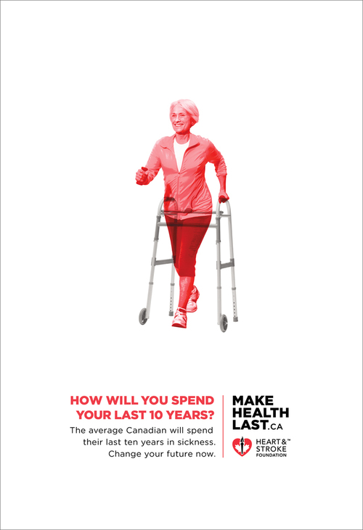

Slide 8
Why does this rhetoric exist?

Slide 9
Demographic Myths
Increased Prevalence of Disease and Disability
Limited Resources
intergenerational conflict
dependency ratios
unsustainability
Wealthy and Undeserving

Slide 10
Why does it matter to health promotion?

Slide 11
Key Concepts from Health and Sociology
Life Course
Social Determinants of Health
Social and Health Inequalities

Slide 12
Key Concepts from Gerontology
Heterogeneity
Biological Aging versus Chronological Aging
Geographies of Aging
Burdening, Caregiving, Volunteerism
Social Relationships

Slide 13
Ideas from Critical Health Promotion
Using critical theories to complicate the issues
The important ‘isms’
Neoliberalism, Individualism, Rationalism
Biomedicalization

Slide 14
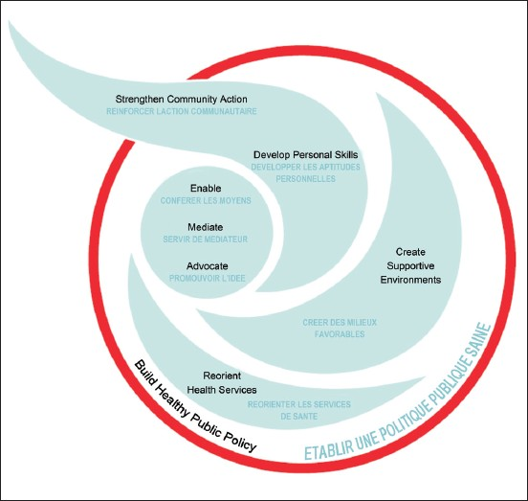

Slide 16
Summary
Like health issues in other vulnerable sub-groups of the population, discussions around aging and health are:
Inherently political
Involve sectors outside of conventional health sectors
Are far more complicated than individual health outcomes

Slide 17
Questions/Discussion
Health Promotion Charter – in what ways can we further health promotion in the context of aging, without focusing on individual level responsibility and behaviour change?
Hidden burden of social and health inequalities in the elderly
As health promoters, how do we develop a more critical and nuanced basis for health and aging?

Slide 18
Thank You.
Janette Leroux
janette.samantha.leroux@queensu.ca

